Slide 1
AACS2192 Analysis and Design of IS – Case Study
Library System

Slide 2
Cost Benefit Summary

Slide 3
Costs
 | YEAR 0 (RM) | YEAR 1 (RM) | YEAR 2 (RM) | YEAR 3 (RM) | YEAR 4 (RM)
Costs:
Hardware | 500,348.90 | 0 | 0 | 0 | 0
Software | 153,052.59 | 95,443.34 | 95,443.34 | 95,443.34 | 95,443.34
Installation cost | 50,762.40 | 0 | 0 | 0 | 0
Operating cost | 12,320.00 | 12,320.00 | 12,320.00 | 12,320.00 | 12,320.00
Development cost | 25,167.60 | 0 | 0 | 0 | 0
Personnel cost | 2,796,000.00 | 2,796,000.00 | 2,796,000.00 | 2,796,000.00 | 2,796,000.00
Total Costs | 3,537,651.49 | 2,903,763.34 | 2,903,763.34 | 2,903,763.34 | 2,903,763.34

Slide 4
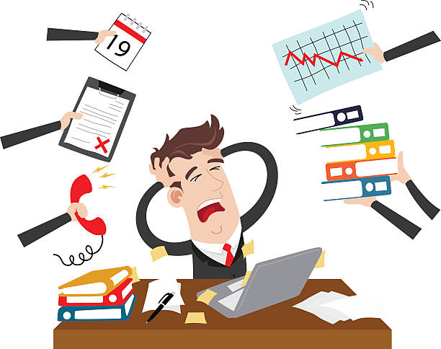


Tangible Benefits
Eliminate Overtime
New Library System can do more
RM1,200 * 50 = RM60,000 per
month * 12 = RM 720,000.00
Eliminate Additional Position
Replace Additional Position
RM4,000 * 60 = RM240,000 per
Month * 12 = RM 2,880,000.00
Eliminate Daily Error
More Accurate Result
RM60,000 per month * 12 =
RM720,000.00

Slide 5
Cost Benefits Summary
 | YEAR 0 (RM) | YEAR 1 (RM) | YEAR 2 (RM) | YEAR 3 (RM) | YEAR 4 (RM)
Costs:
Hardware | 500,348.90 | 0 | 0 | 0 | 0
Software | 153,052.59 | 95,443.34 | 95,443.34 | 95,443.34 | 95,443.34
Installation cost | 50,762.40 | 0 | 0 | 0 | 0
Operating cost | 12,320.00 | 12,320.00 | 12,320.00 | 12,320.00 | 12,320.00
Development cost | 25,167.60 | 0 | 0 | 0 | 0
Personnel cost | 2,796,000.00 | 2,796,000.00 | 2,796,000.00 | 2,796,000.00 | 2,796,000.00
Total Costs | 3,537,651.49 | 2,903,763.34 | 2,903,763.34 | 2,903,763.34 | 2,903,763.34
Benefits:
Eliminate Overtime | 720,000.00 | 720,000.00 | 720,000.00 | 720,000.00 | 720,000.00
Eliminate Additional Position | 2,880,000.00 | 2,880,000.00 | 2,880,000.00 | 2,880,000.00 | 2,880,000.00
Eliminate Daily Error | 720,000.00 | 720,000.00 | 720,000.00 | 720,000.00 | 720,000.00
Total Benefits | 4,320,000.00 | 4,320,000.00 | 4,320,000.00 | 4,320,000.00 | 4,320,000.00

Slide 6
Intangible Benefits

Slide 7




Intangible Benefits
Improve Reliability and Security
Improve Library Image
Improve Librarian Morale

Slide 8
Sample Summary of
Questionnaire and Interview

Slide 9
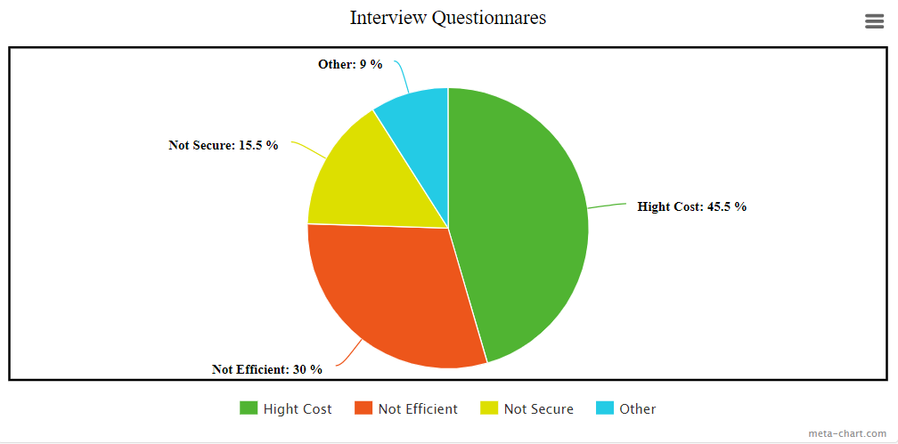
Summary of interview for employee

Slide 10
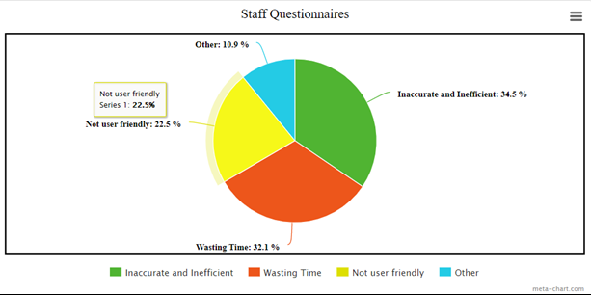
Summary of questionnaires for staff

Slide 11
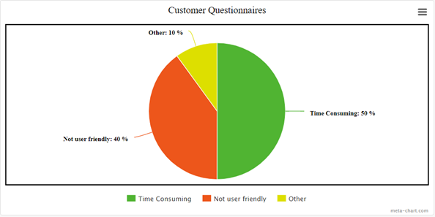
Summary of questionnaires for customer

Slide 12
Functional Diagram

Slide 13
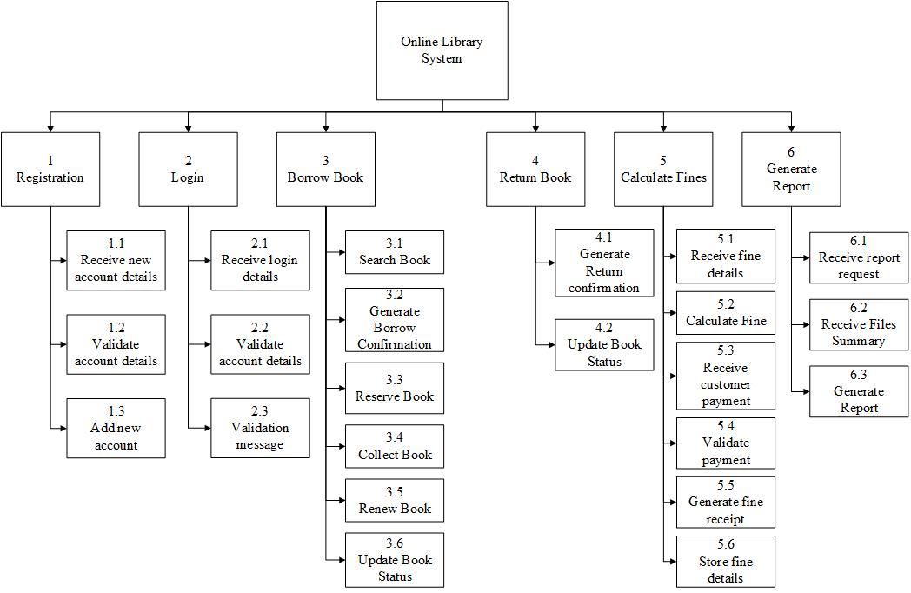
Functional Diagram

Slide 14

Functional Diagram
1 Registration
1.1 Receive new account details
User’s details, account’s registration username, password
1.2 Validate account details
Compare the registration details with the database
1.3 Add new account
Add new account into database

Slide 15

Functional Diagram
2 Login
2.1 Receive account details
Account’s username, password
2.2 Validate account details
Compare the login details with the database
2.3 Validation message
Outputs login confirmation message

Slide 16

Functional Diagram
3 Borrow Book
3.1 Search Book
Search the books inside database
3.2 Generate Borrow Confirmation
Output borrow confirmation message
3.3 Reserve Book
Reserve book on account
3.4 Collect Book
Generate collection date
3.5 Renew Book
Renew return’s date
3.6 Update Book Status
Update book’s file

Slide 17

Functional Diagram
4 Return Book
4.1 Generate Return Confirmation
Output return confirmation message
4.2 Update Book Status
Update Book’s file

Slide 18

Functional Diagram
5 Calculate Fines
5.1 Receive fine details
Receive details from fine file
5.2 Calculate Fine
Calculate with a rate
5.3 Receive customer payment
Request for payment
5.4 Validate Payment
Check with the banks
5.5 Generate fine receipt
Generate digital copy or physical copy
5.6 Store fine details
Update fine details in fine file

Slide 19

Functional Diagram
6 Generate Report
6.1 Receive report request
Receive request from user
6.2 Receive Files Summary
Receive from files
6.3 Generate Report
Generate several report daily

Slide 20

System Design - Inputs

Slide 21

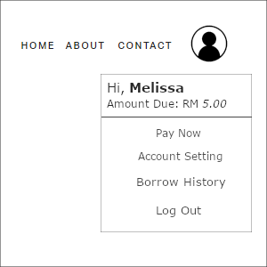

Slide 22
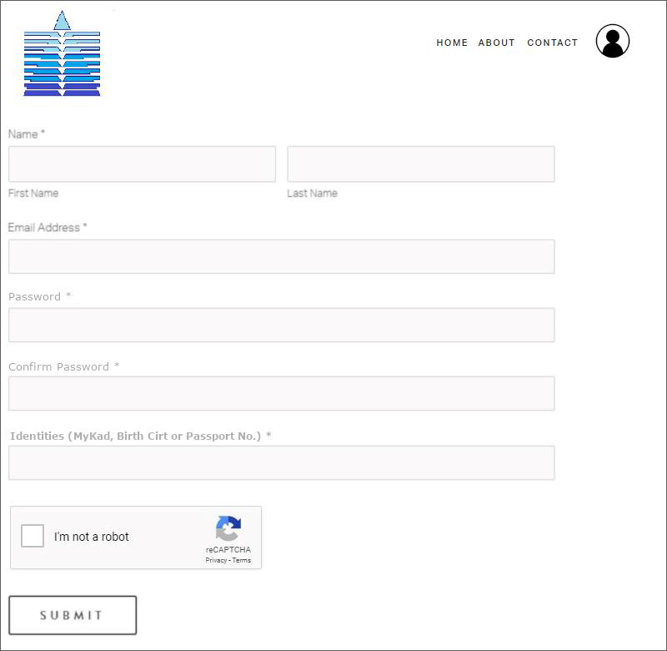
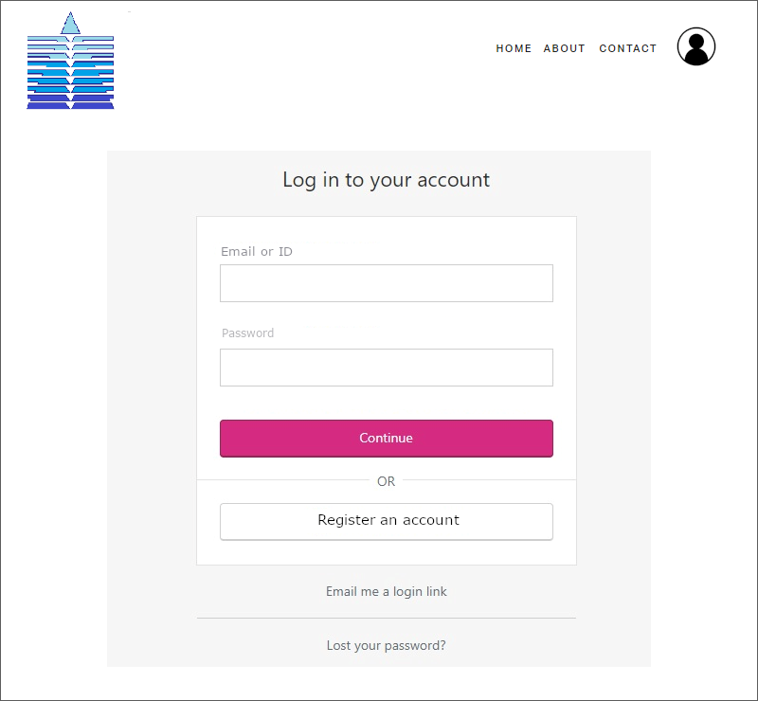
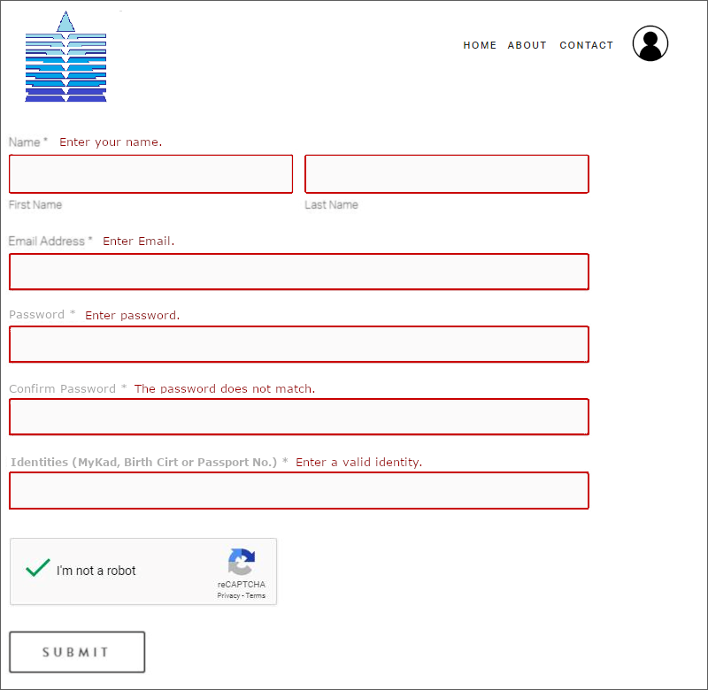
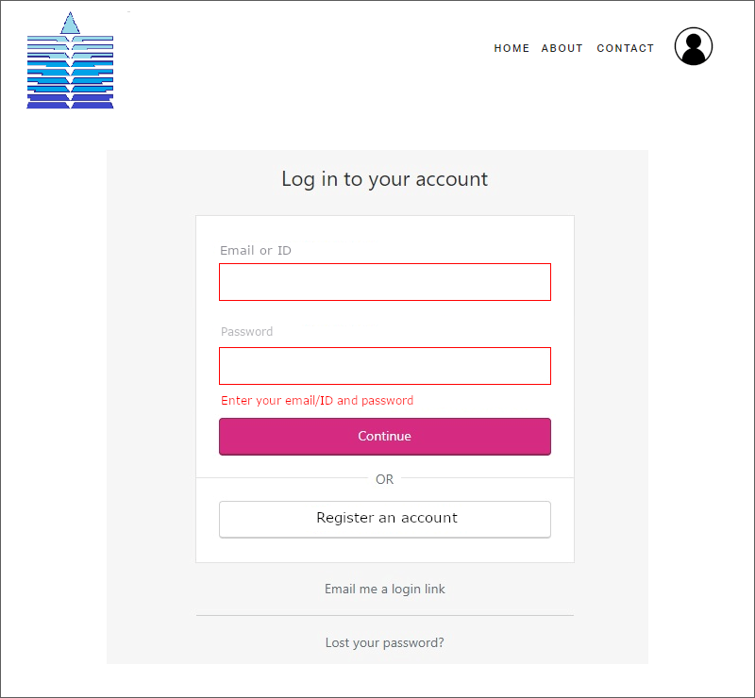
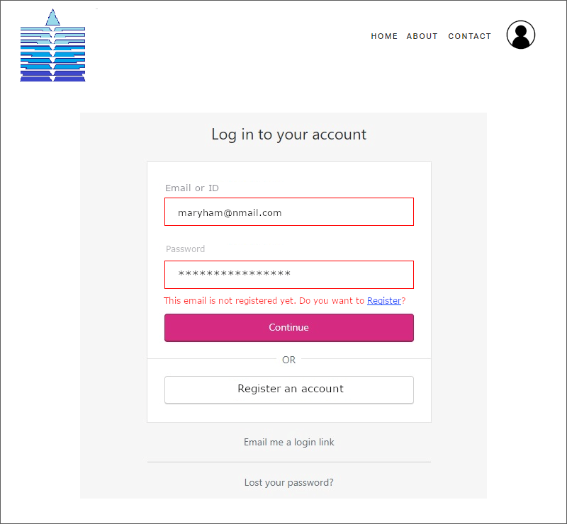
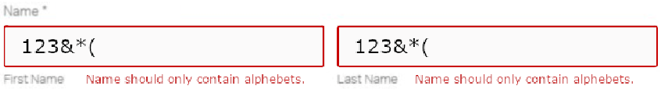





Slide 23
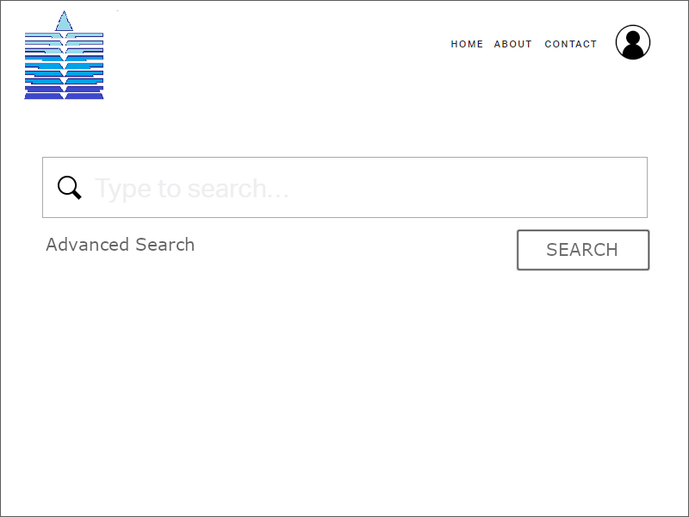

Slide 24
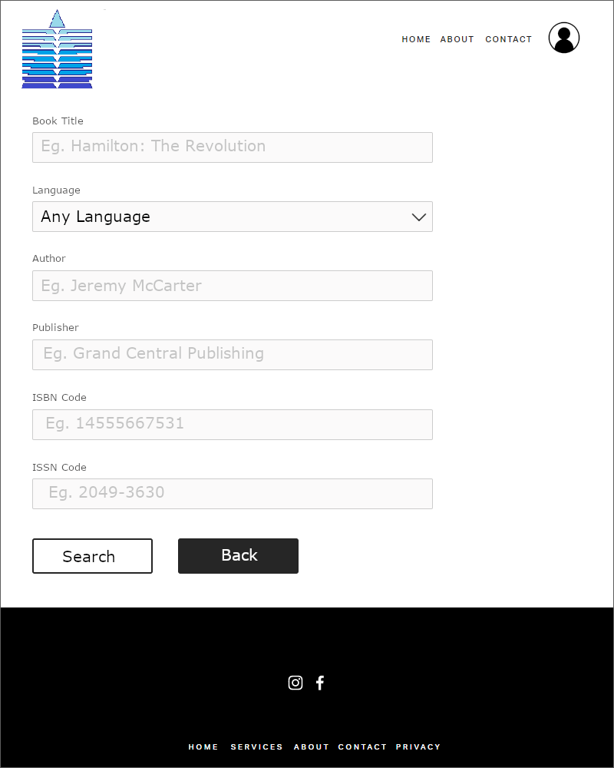

Slide 25
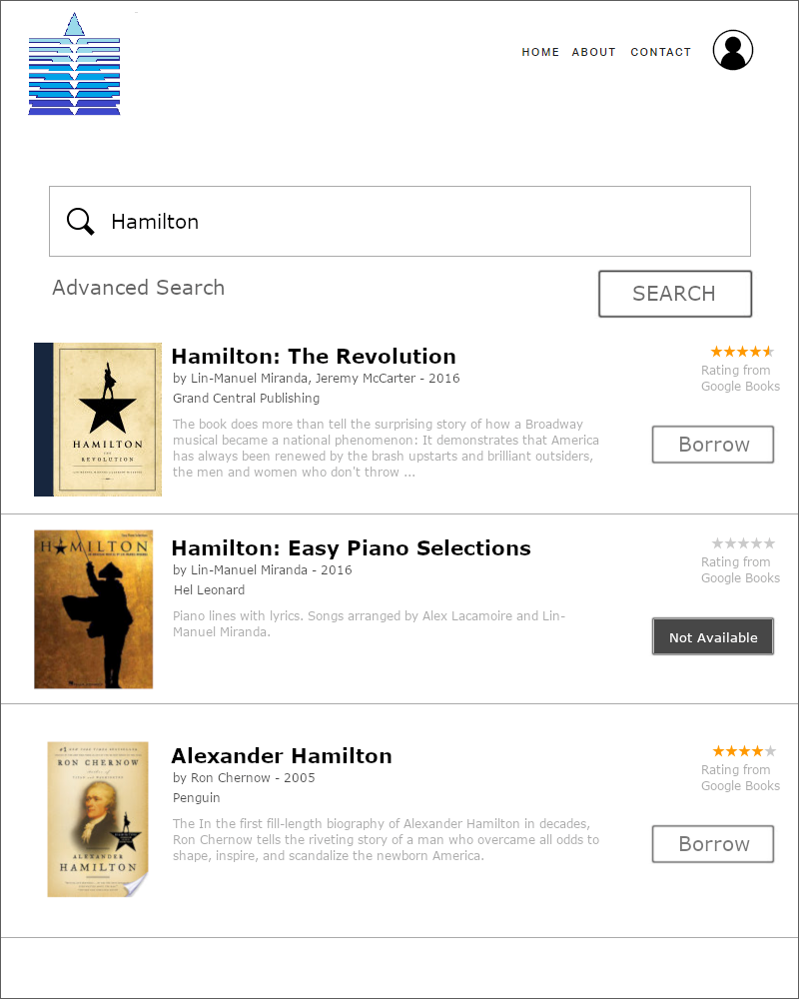

Slide 26
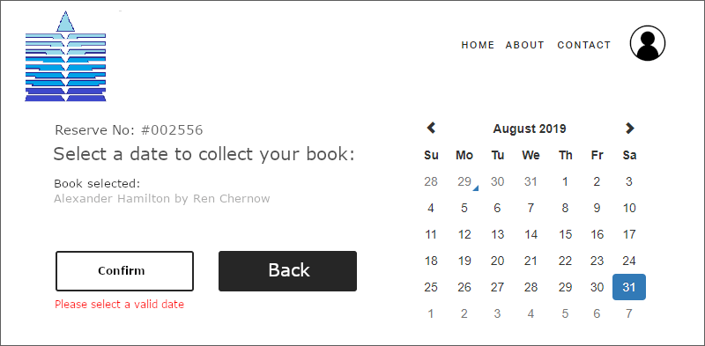
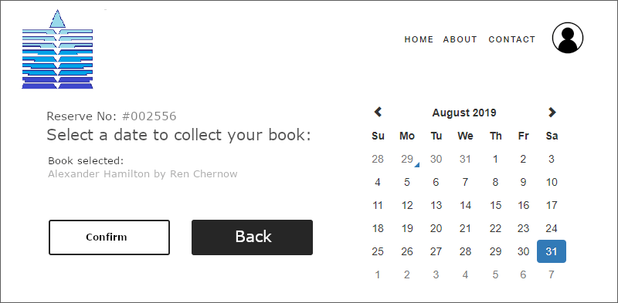
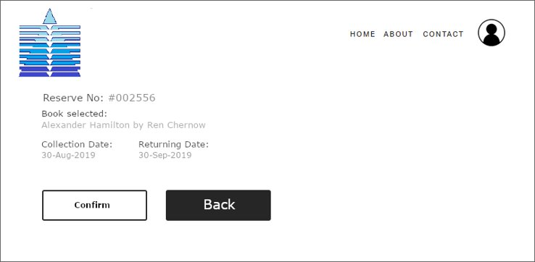

Slide 27
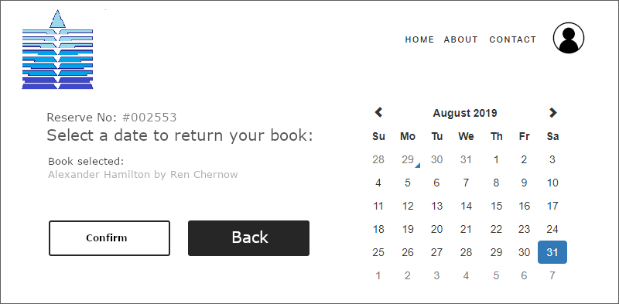
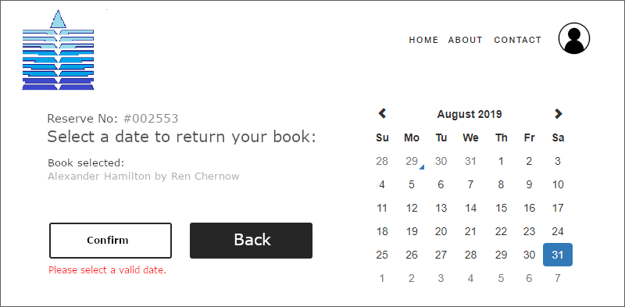
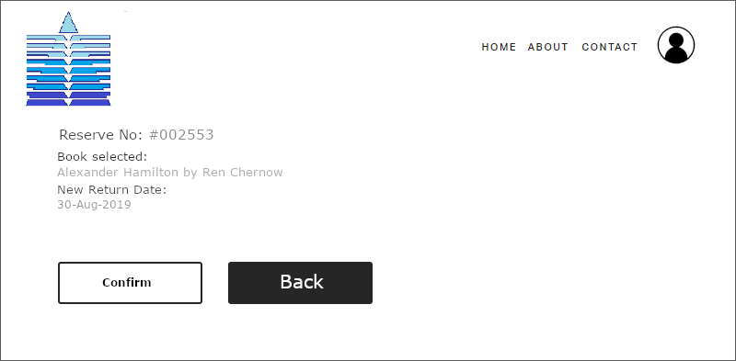

Slide 28
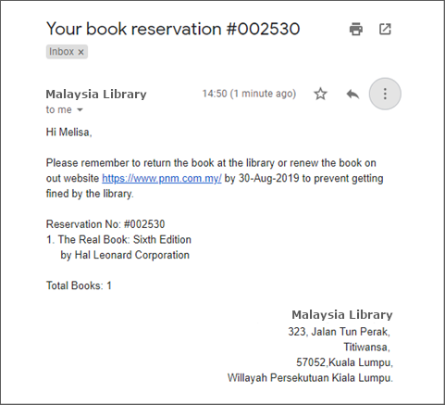

Slide 29
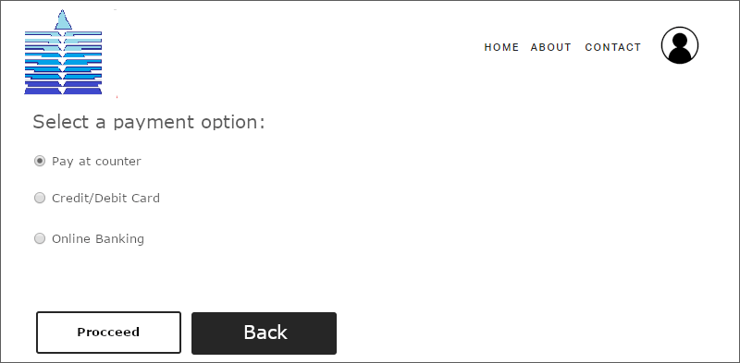
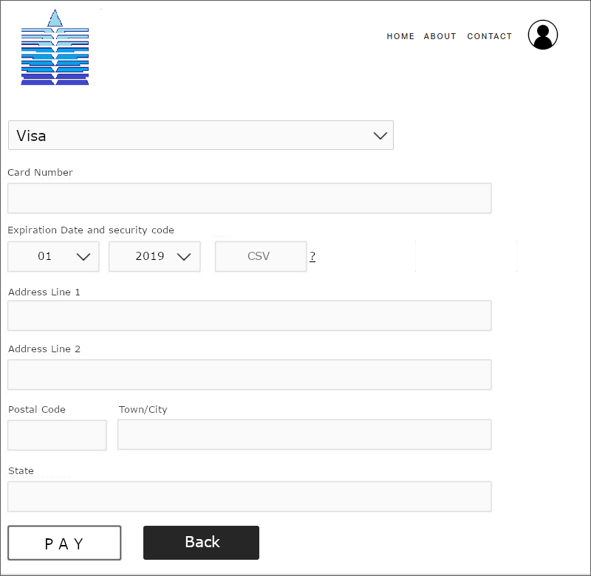
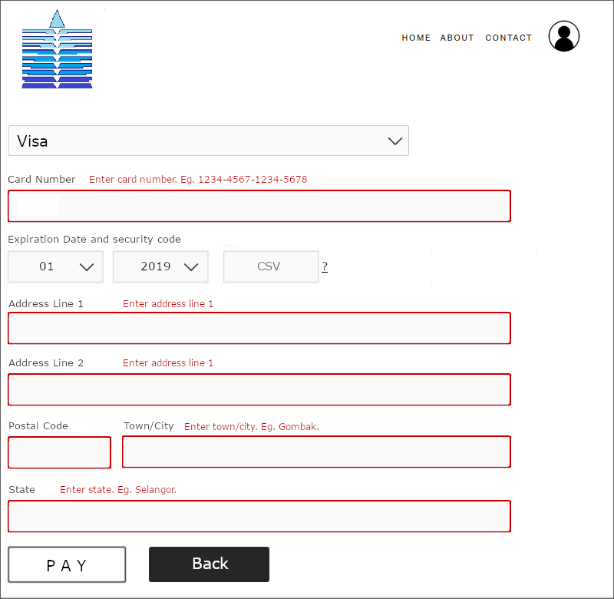



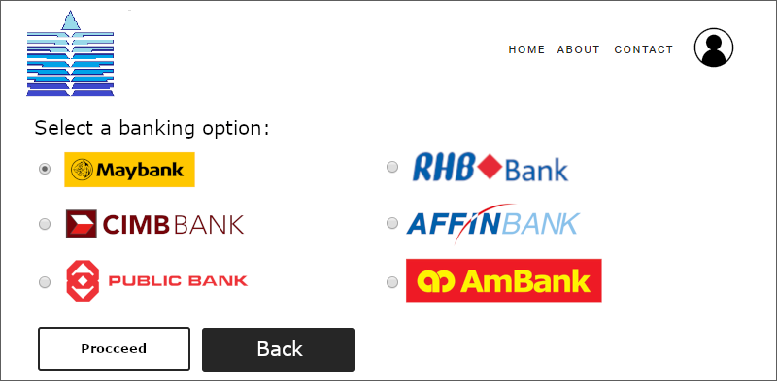

Slide 30
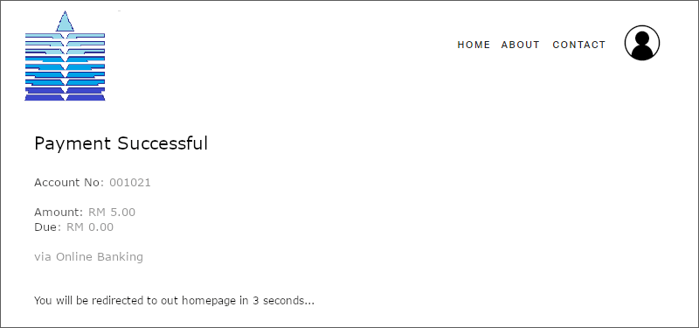

Slide 31
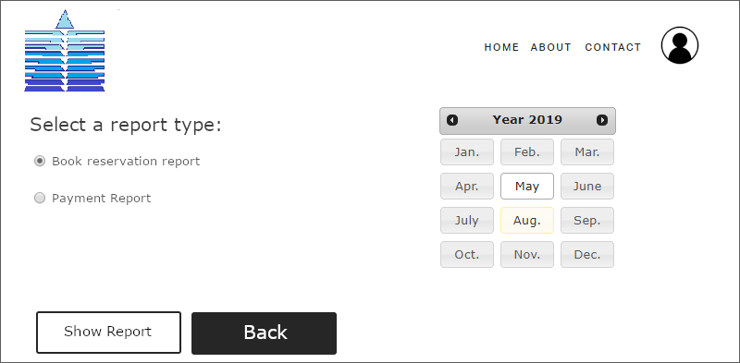

Slide 32

System Design – Outputs / Reports

Slide 33
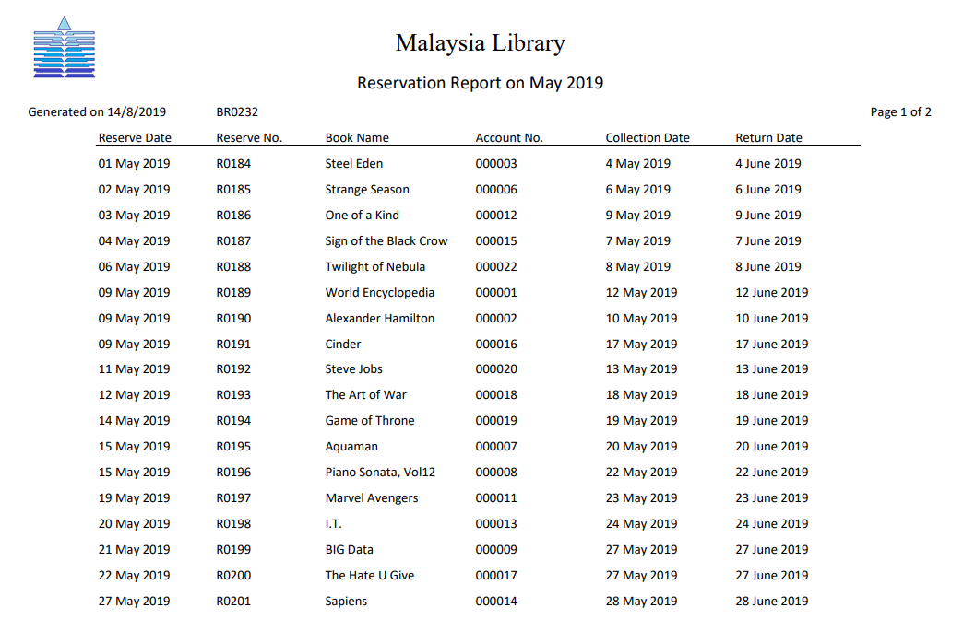
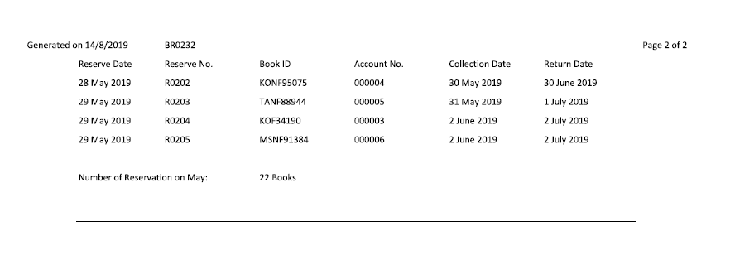
Detail Report
User:
Librarian
Purpose:
To make decision to increase the number of reservation

Slide 34
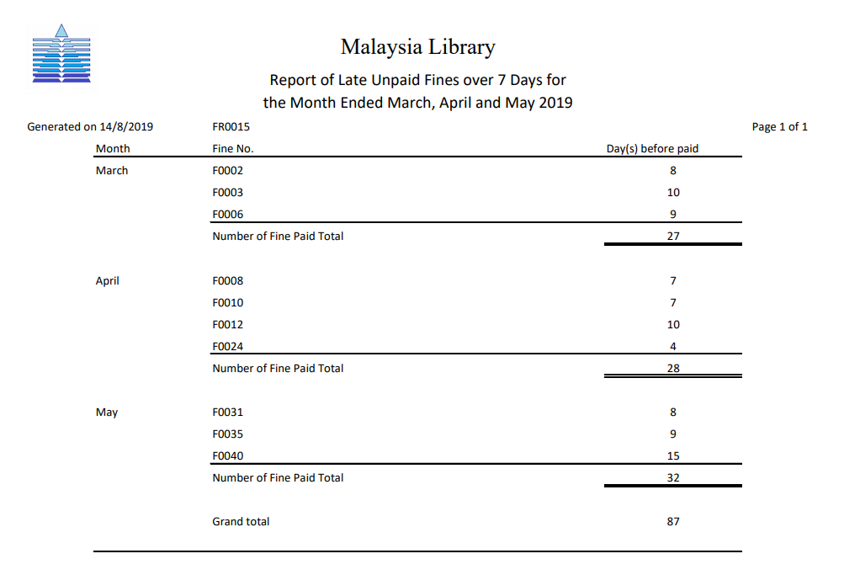
Exception Report
User:
Library Manager
Purpose:
To make decision to make more efforts to decrease the number of days before fine paid overall.

Slide 35
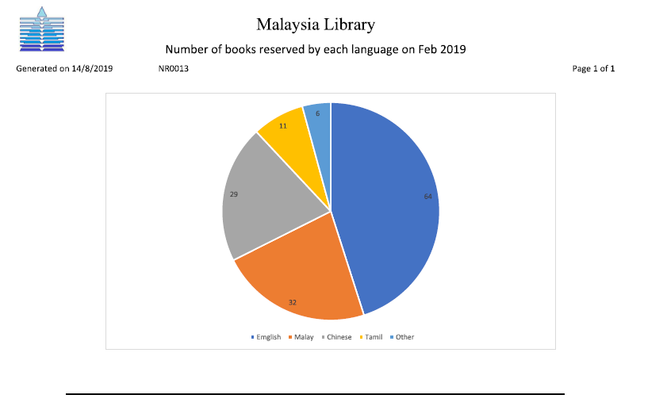
Summary Report
User:
Library Manager
Purpose:
To make sure the number of books can be reserved is adequate.

Slide 36
Principle of Good Report Design
Appropriate Report Title
- Name
- Revision
- Length

Slide 37
Principle of Good Report Design
Pleasing Report Layout
- Lable
- Spacing
- Attractive

Slide 38

Principle of Good Report Design
Meaningful Report Content
- Relevant
- Accuracy
- Title

Slide 39

Principle of Good Report Design
Other
- Ending Line
- Reliable

